Slide 1
PRESENTATION TITLE
Mirjam Nilsson​

Slide 2
Introduction​
HTML in Action
Doctype
HTML Page Structure
Typography
Lists
Images
Forums
Links
Divisions and Spans
Comments

Slide 3
Introduction
-Frontend
-Backend
-Full Stack

Slide 4
HTML in Action

Slide 5
Doctype

Slide 6
HTML Page Structure

Slide 7
Typography

Slide 8
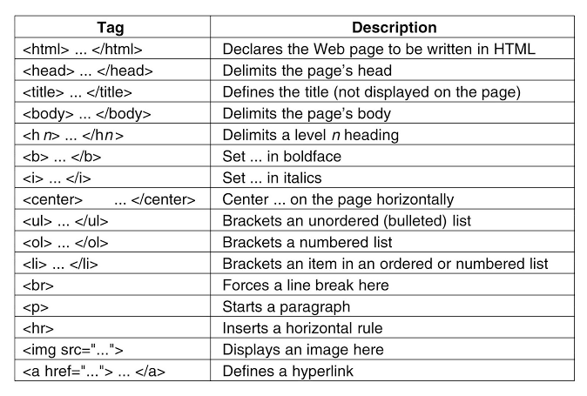
Typography

Slide 9
Lists

Slide 10
Images

Slide 11
Forums

Slide 12
Links

Slide 13
Divisions and Spans

Slide 14
Comments

Slide 15
THANK YOU
Mohamed Khalil Brik
Mohamedkhalil.brik@aucegypt.edu

